Slide 1
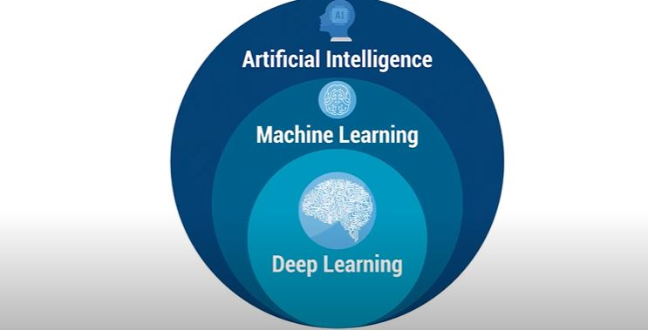

Slide 2
Introduction Basic machine Learning

Slide 3
Machine learning is an application of artificial intelligence (AI) that provides systems the ability to automatically learn and improve from experience without being explicitly programmed. Machine learning focuses on the development of computer programs that can access data and use it learn for themselves.

Slide 4
It is a branch of artificial intelligence based on the idea that systems can learn from data, identify patterns and make decisions with minimal human intervention

Slide 5
Machine learning at its most basic is the practice of using algorithms to parse data, learn from it, and then make a determination or prediction about something in the world

Slide 6
How does Machine Learning Work?

Slide 7
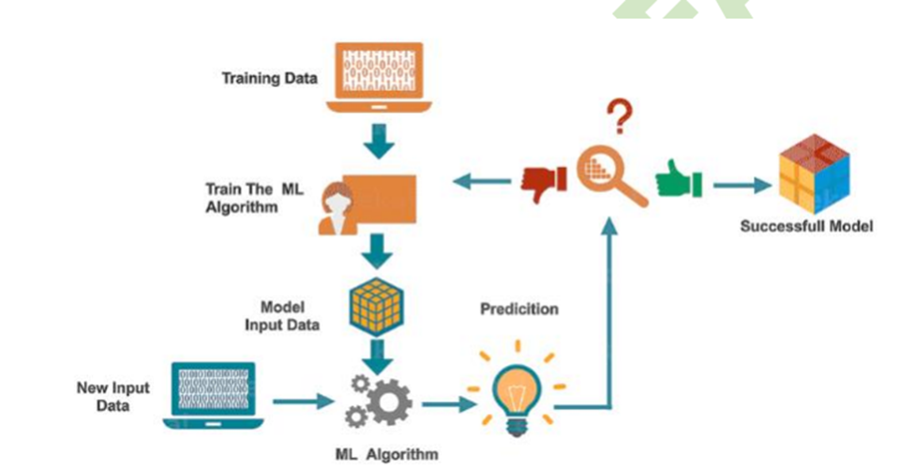

Slide 8
Steps of Machine Learning

Slide 9
1 - Data Collection
2 - Data Preparation
3 - Choose a Model
4- Train the Model
5 - Evaluate the Model
6 - Parameter Tuning
7 - Make Predictions

Slide 10
Feature Engineering

Slide 11
Steps in Feature Engineering

Slide 12
Select data - selecting correct features and integrate all of them into a dataset.
Preprocess the data - Format the data, clean it, add new features, etc.
Model the data - Creating models, evaluating them and tuning them

Slide 13
Terminologies that one should know before starting Machine Learning:

Slide 14
Model
Feature
Target(Label)
Training
Prediction

Slide 15
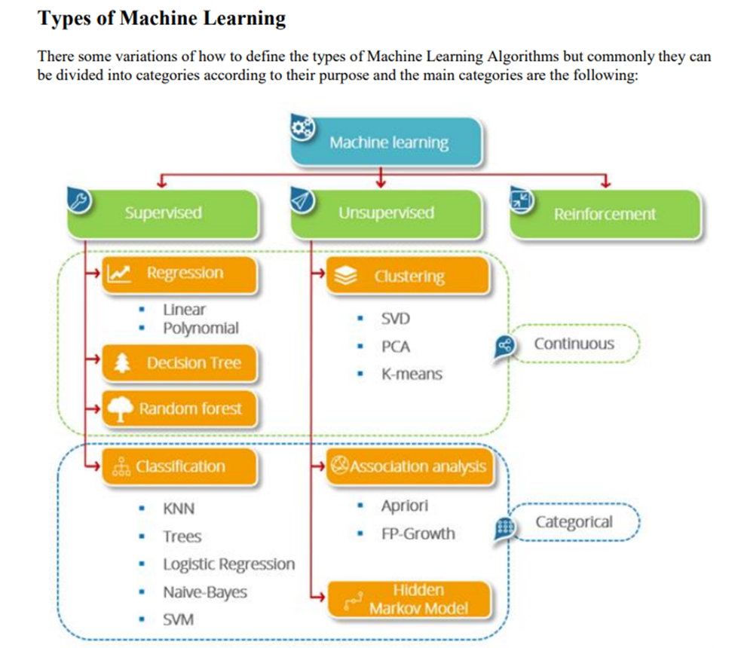

Slide 16
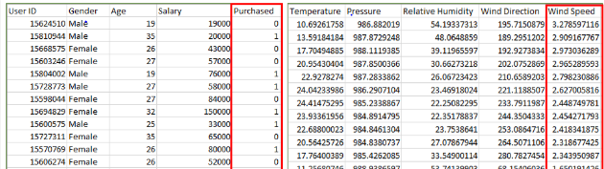
Supervised Learning:

Slide 17
Types of Supervised Learning:
  Classification
  Regression

Slide 18
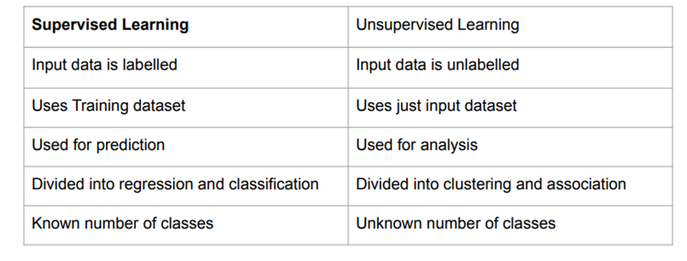

Slide 19
Types of Unsupervised Learning:
  Clustering
  Association

Slide 20
Applications Of RL

Slide 21
In self-driving cars
Industry Automation
Stock Market Trading

Slide 22
Introduction To Deep Learning & Neural Networks.

Slide 23
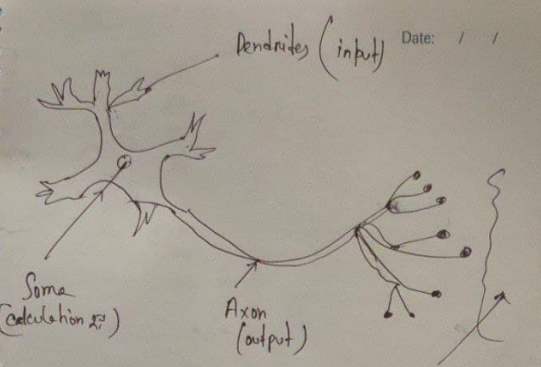

Slide 24
Deep learning is a subset of machine learning in which multi-layered neural networks—modeled to work like the human brain and they learn from large amounts of data.

Slide 25
Some Example of Deep Learnings are:
Image Classification
Detection
Face Detection
Voice Assistance
We actually need Deep learning to process large amount of Data. For processing large amount of data it needs powerful processing machine as well

Slide 26
How deep learning Works ?
Uses a neural network to imitate the intelligence of animals.
The neurons are grouped into 3 layers - input, output and hidden layer.
Deep Learning can be both supervised or unsupervised.

Slide 27
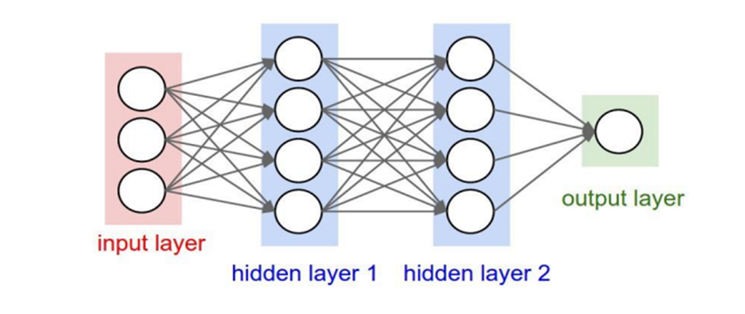

Slide 28
Common Deep Learning Algorithms
Multi-Layer Perceptron (MLP)
Convolutional Neural Network (CNN)
Recurrent Neural Networks (RNN)
Long Short Term Memory Networks (LSTMs)
Generative Adversarial Networks (GANs)
Autoencoders

Slide 29
Introduction To Natural Language Processing

Slide 30
Machine learning data only works with numerical features so we have to convert text data into numerical columns. So we have to preprocess the text and that is called natural language processing.
In-text preprocess we are cleaning our text by steaming, lemmatization, remove stopwords, remove special symbols and numbers, etc. After cleaning the data we have to feed this text data into a vectorizer which will convert this text data into numerical features.

Slide 31
Basic NLP Terminologies

Slide 32


Slide 33
Tokenization
Normalization
Stemming
Lemmatization
Stop words

Slide 34
Some Common NLP Algorithms

Slide 35
TF-IDF - Full form is Term Frequency-Inverse Document Frequency. It aims on defining how significant a word is in a document. Also it considers the relation between other documents from the same corpus. It is a keyword extraction algorithm.

Slide 36
Deep Learning algorithms such as - convolutional neural network, recurrent neural network, lstm, etc can also be used. Reinforcement Learning can also be used in some NLP tasks such as - image captioning and machine translation.

Slide 37


Slide 38
